Slide 1

Amazon Review Data Analysis Sentiment Analysis and Predictive Modeling
Kortney Cose, Michael Haile, Jay (Jerome) Manion

Slide 2


Project Overview
Objective
Analyze Amazon review data for sentiment and classification
Goals
Clean and preprocess amazon review data
Preform sentiment analysis
Visualize Results
Build Predictive Models
Explore Clustering Patterns

Slide 3
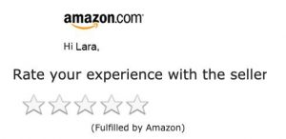
Dataset
Amazon Product Review Data
https://www.kaggle.com/datasets/arhamrumi/amazon-product-reviews
Attributes used
Score (1-5 rating)
Text (text review of product)

Slide 4
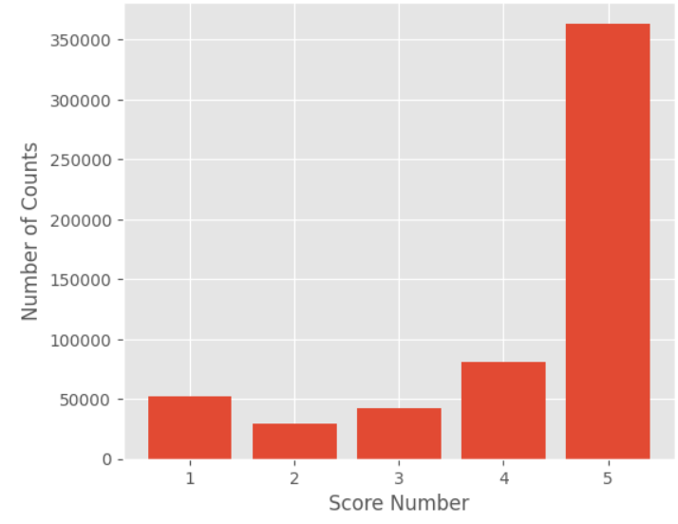
Ratings Count
Total count of ratings score
5 – 363,102
4 – 80,654
3 – 52,264
2 – 42,638
1 - 29,743

Slide 5
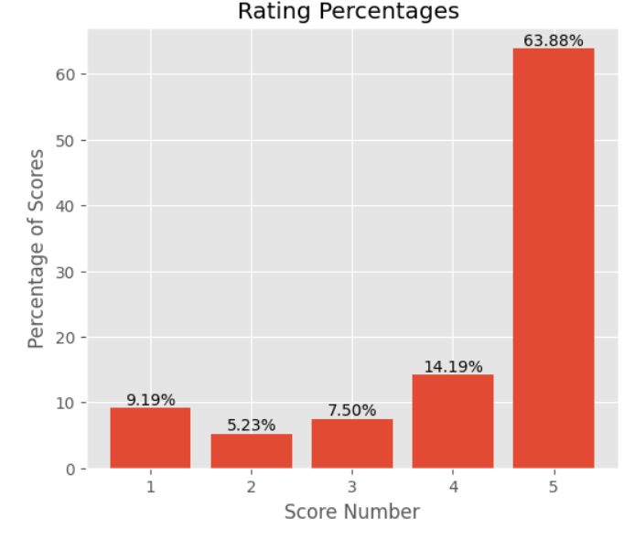

Percentage distribution of product ratings

Slide 6
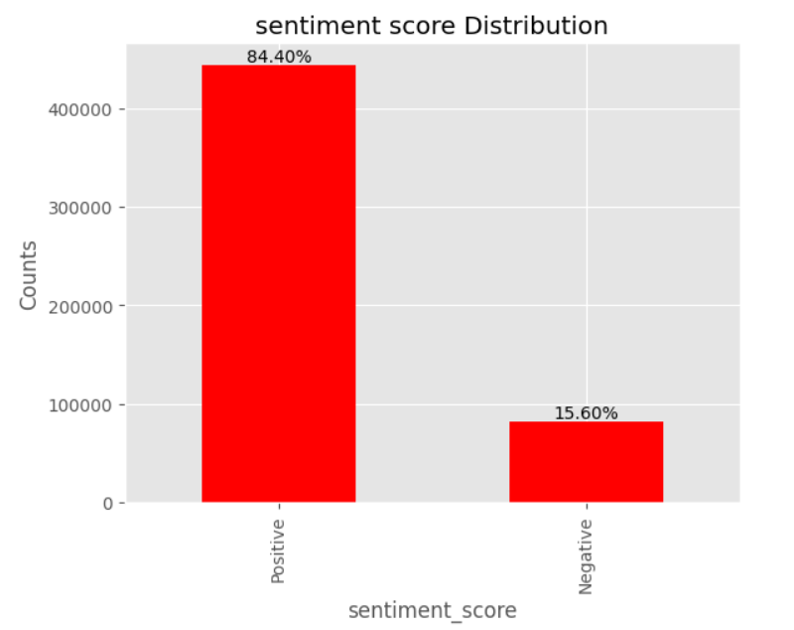
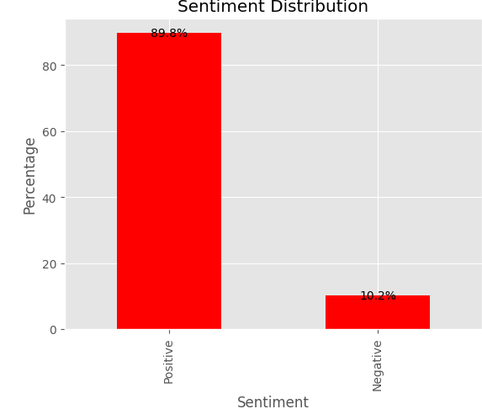
Sentiment Distribution
Rating Distribution
Text Sentiment Distribution
> 3, Positive
= 3, Neutral
< 3, Negative
> 0, Positive
= 0, Neutral
< 0, Negative

Slide 7

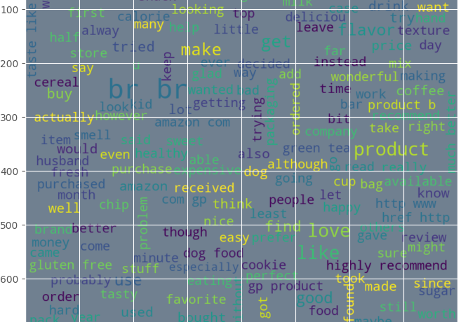
Word Cloud

Slide 8
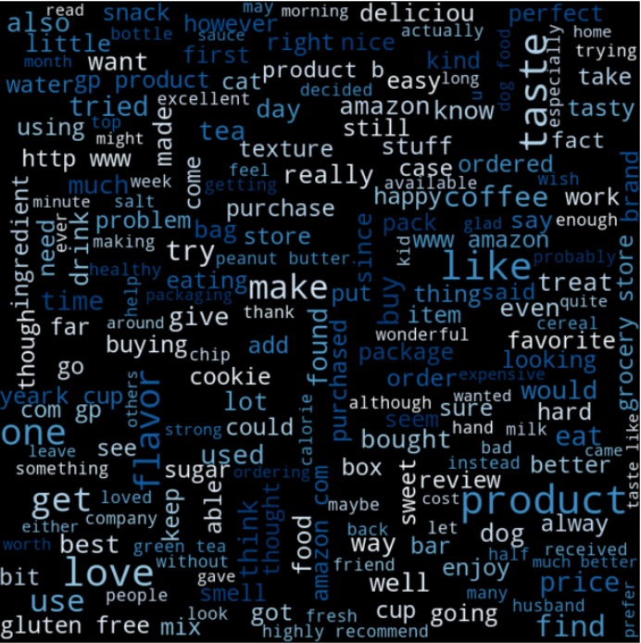
POSITIVE WORDCLOUD
Like
Love
Product
Taste
Flavor
Delicious
Price

Slide 9
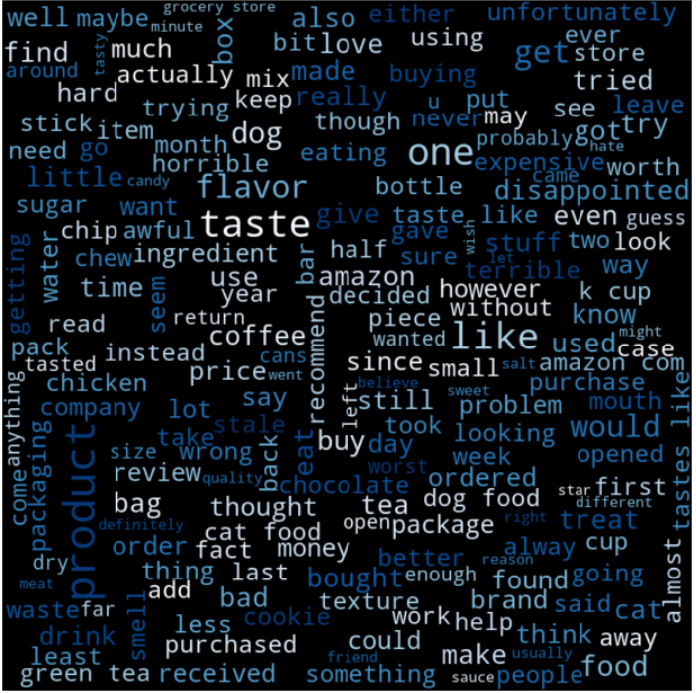
NEGATIVE WORDCLOUD
Taste
Flavor
Like
Product
Disappointed
Expensive
Horrible

Slide 10
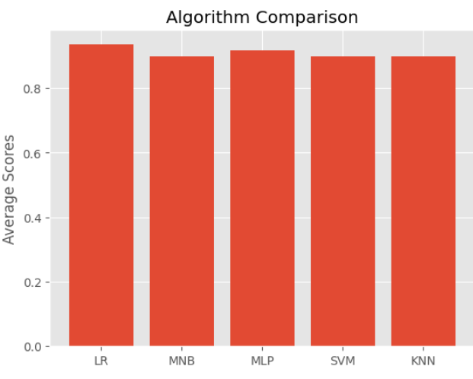

Machine Learning Models

Slide 11
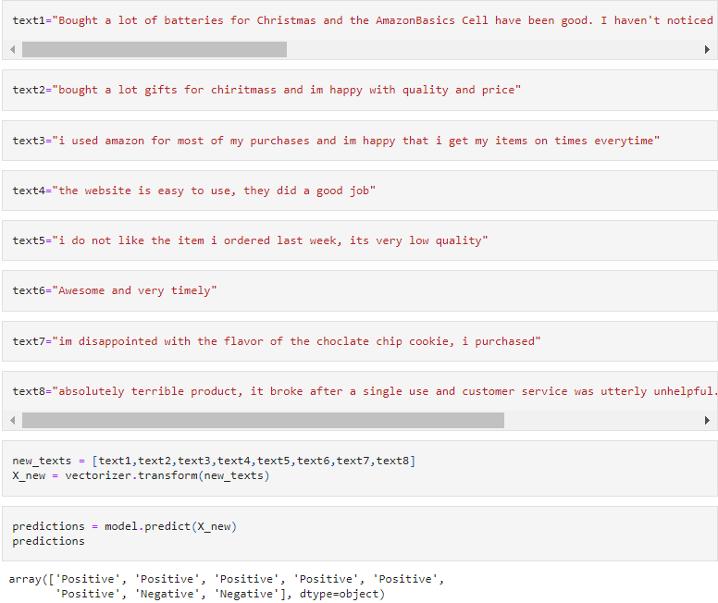
Predictions

Slide 12
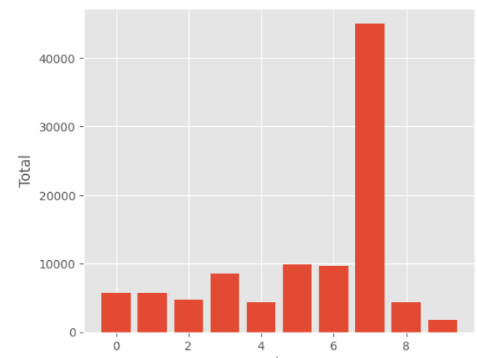
Cluster Means

Slide 13
Top 30 most Common WORDs/TEXT found in Clusters

Slide 14
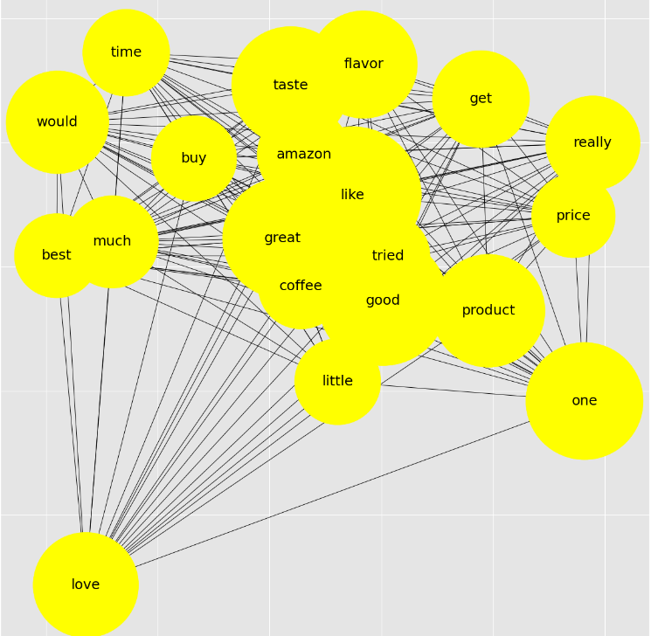
Network word Graph

Slide 15
Key Points of Sentiment Analysis
Customer Feedback
Product Improvement
Feature Analysis
Market Research
Decision Making

Slide 16

QUESTIONS? Reviews???

